Slide 1

Automating INFORMS Analytics Capability Assessments with AWS
VCU DAPT Alumni Meetup 12JAN19
Jerome Dixon

Slide 2
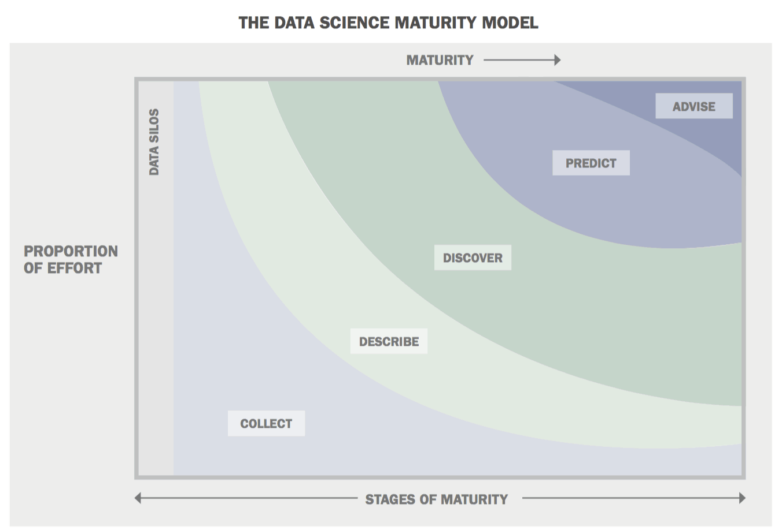
INFORMS Analytics Capability Assessments (ACA)
ACAs are designed to assess where an organization lies on data science spectrum
*Booz Allen Hamilton Data Science Maturity Model
Notes:
The INFORMS Analytics Maturity Model (IAMM) is designed to provide information whether your organization is at an initial, developing, or advanced level of analytics. It helps you assess your strengths and weaknesses in three broad areas of analytics:
your organization
its analytics capability
its data & infrastructure
and drills down with a dozen peering questions that provide broad analytics understanding.

Slide 3
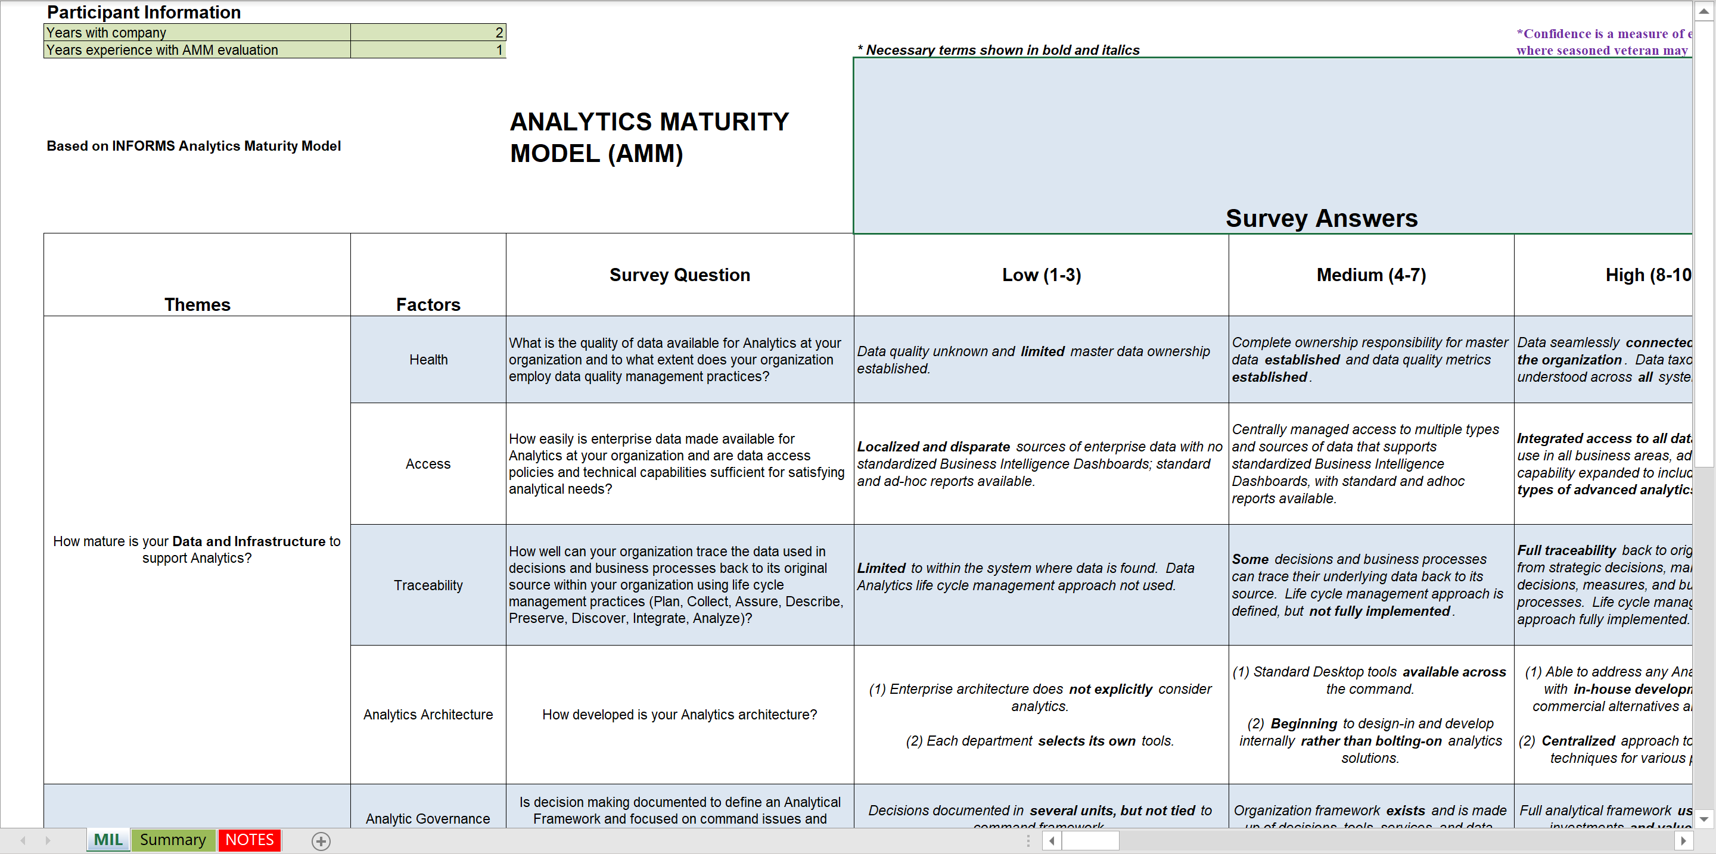
Input Format
Notes:
The INFORMS Analytics Maturity Model (IAMM) is designed to provide information whether your organization is at an initial, developing, or advanced level of analytics. It helps you assess your strengths and weaknesses in three broad areas of analytics:
your organization
its analytics capability
its data & infrastructure
and drills down with a dozen peering questions that provide broad analytics understanding.

Slide 4
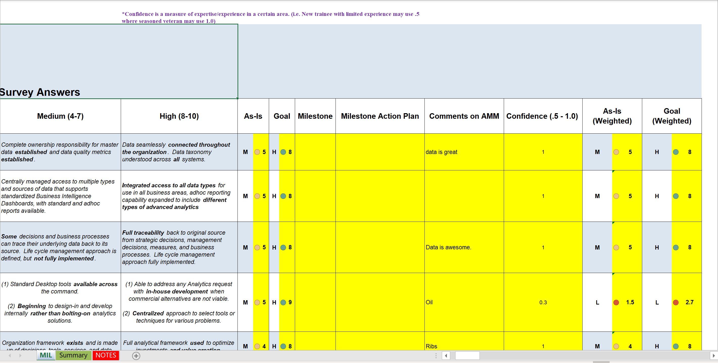
Input Format
Notes:
The INFORMS Analytics Maturity Model (IAMM) is designed to provide information whether your organization is at an initial, developing, or advanced level of analytics. It helps you assess your strengths and weaknesses in three broad areas of analytics:
your organization
its analytics capability
its data & infrastructure
and drills down with a dozen peering questions that provide broad analytics understanding.

Slide 5
What are we going to do?
Step 1: S3 Bucket
a. Create Bucket
b. IAM Permissions
Step 2: Simple Email Service (SES)
a. Create email account
b. IAM Permissions
c. Create Rule for S3
Step 3: RStudio
a. AWS Keys
b. AWS Client Packages (R/Python)
c. File Processing/Data Munging

Slide 6
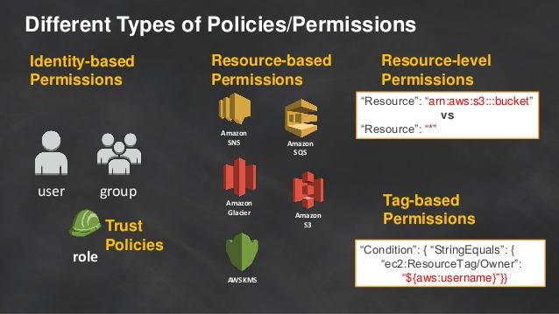
What are we NOT going to do?
https://www.slideshare.net/AmazonWebServices/become-an-iam-policy-ninja
Notes:
Create AWS account
IAM Policies

Slide 7
What are we going to do?
Step 1: S3 Bucket
a. Create Bucket
b. IAM Permissions
Step 2: Simple Email Service (SES)
a. Create email account
b. IAM Permissions
c. Create Rule for S3
Step 3: RStudio
a. AWS Keys
b. AWS Client Packages (R/Python)
c. File Processing/Data Munging

Slide 8
Resources
Code and training resources posted here: https://drive.google.com/drive/folders/1IrmF1uLnbOZ3f67z8S8XKSJqBkDigL1p?usp=sharing

